Slide 1
Linked list
A link list is a collection of elements called nodes each node hap two parts, 1 st part contains the information field & the 2nd part contains the address of the next node. The address part of the last node of linked list will have null value.

Slide 2
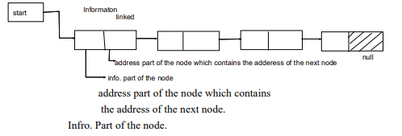

Slide 3
In liked list one member is a pointer that points to a structure itself.
Syntax:-
Struct node
{
Int data;
Struct node * link;
};
Here, member of the structure struct node * link points to the structures itself.

Slide 4
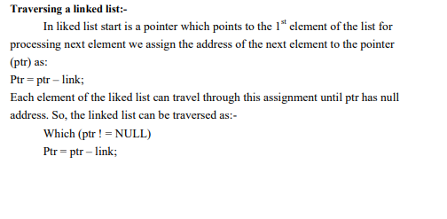
Implementation:-

Slide 5
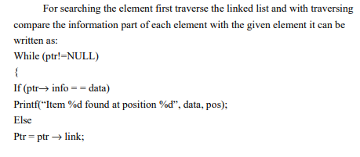
Searching in to a linked list:

Slide 6
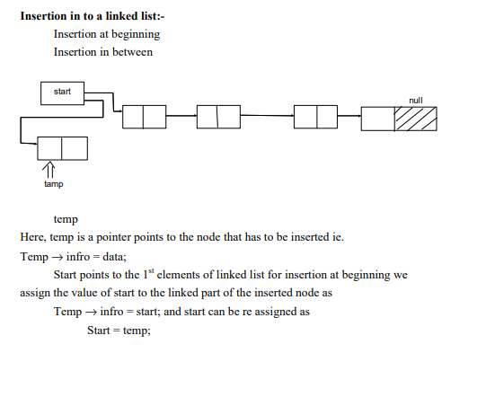

Slide 7
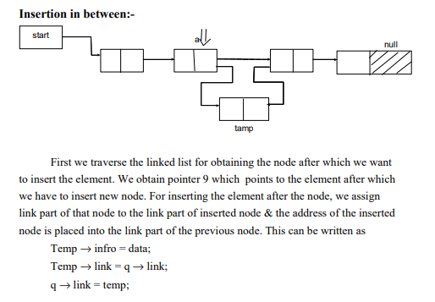

Slide 8
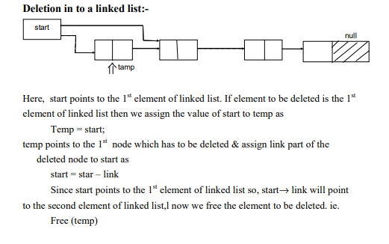

Slide 9
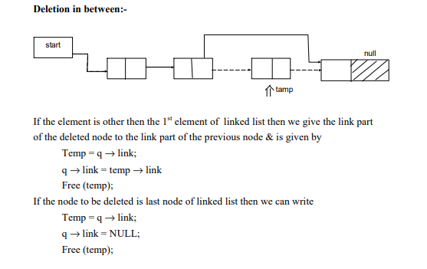

Slide 10
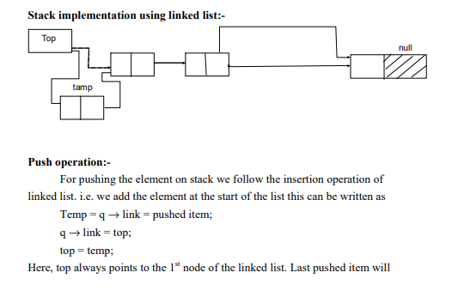

Slide 11
become 1st node of linked list. As there is use of linked list we don’t check overflow condition.

Slide 12
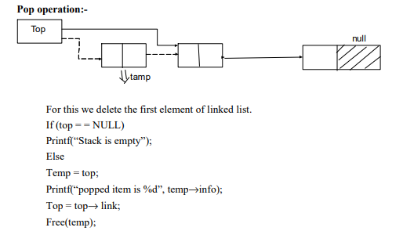

Slide 13
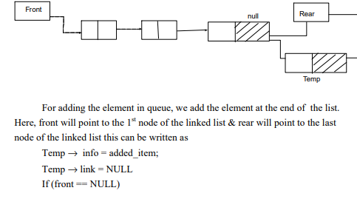
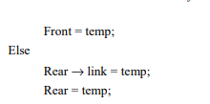
Queue implementation using linked list:-

Slide 14
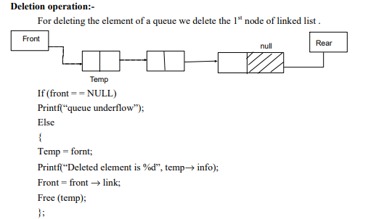

Slide 15
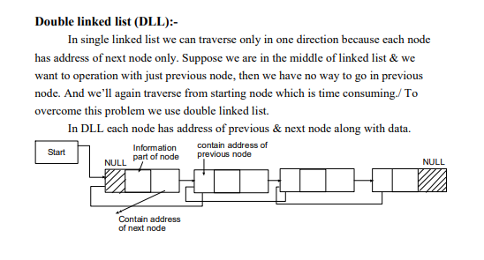

Slide 16
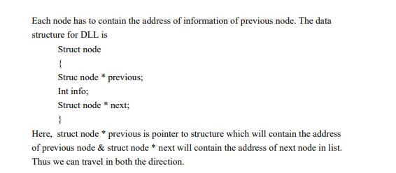

Slide 17
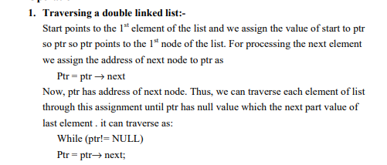

Slide 18
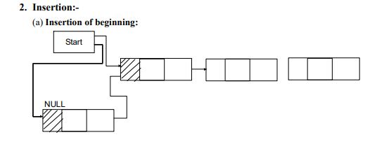

Slide 19
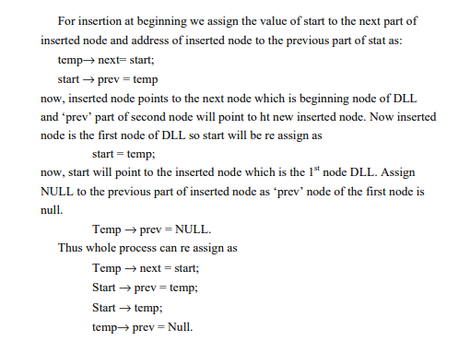

Slide 20
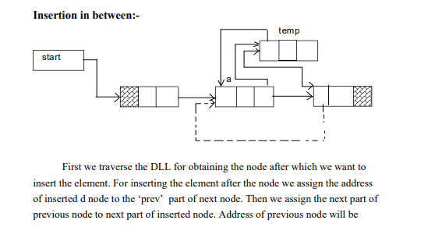

Slide 21
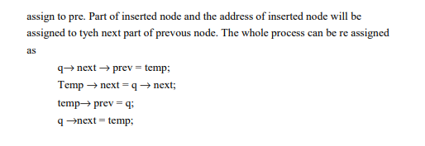

Slide 22
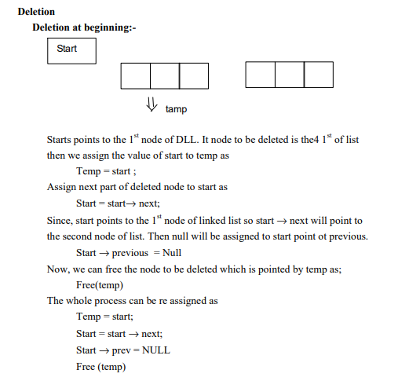

Slide 23
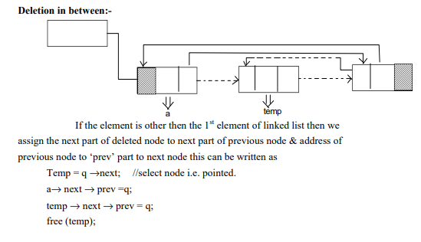

Slide 24
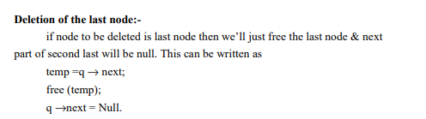

Slide 25
Advantages, Disadvantages, and uses of Doubly Linked List
Reversing the doubly linked list is very easy.
It can allocate or reallocate memory easily during its execution.
As with a singly linked list, it is the easiest data structure to implement.
The traversal of this doubly linked list is bidirectional which is not possible in a singly linked list.
Deletion of nodes is easy as compared to a Singly Linked List. A singly linked list deletion requires a pointer to the node and previous node to be deleted but in the doubly linked list, it only required the pointer which is to be deleted.

Slide 26
Disadvantages Of DLL:
It uses extra memory when compared to the array and singly linked list.
Since elements in memory are stored randomly, therefore the elements are accessed sequentially no direct access is allowed.

